Slide 1


SMART INDIA HACKATHON 2025
Problem Statement ID – 25002
Problem Statement Title- Smart Tourist Safety Monitoring & Incident Response System using Al, Geo-Fencing, and Blockchain-based Digital ID
Theme- Travel & Tourism
PS Category- Software
Team Name - Blueblaze

Slide 2
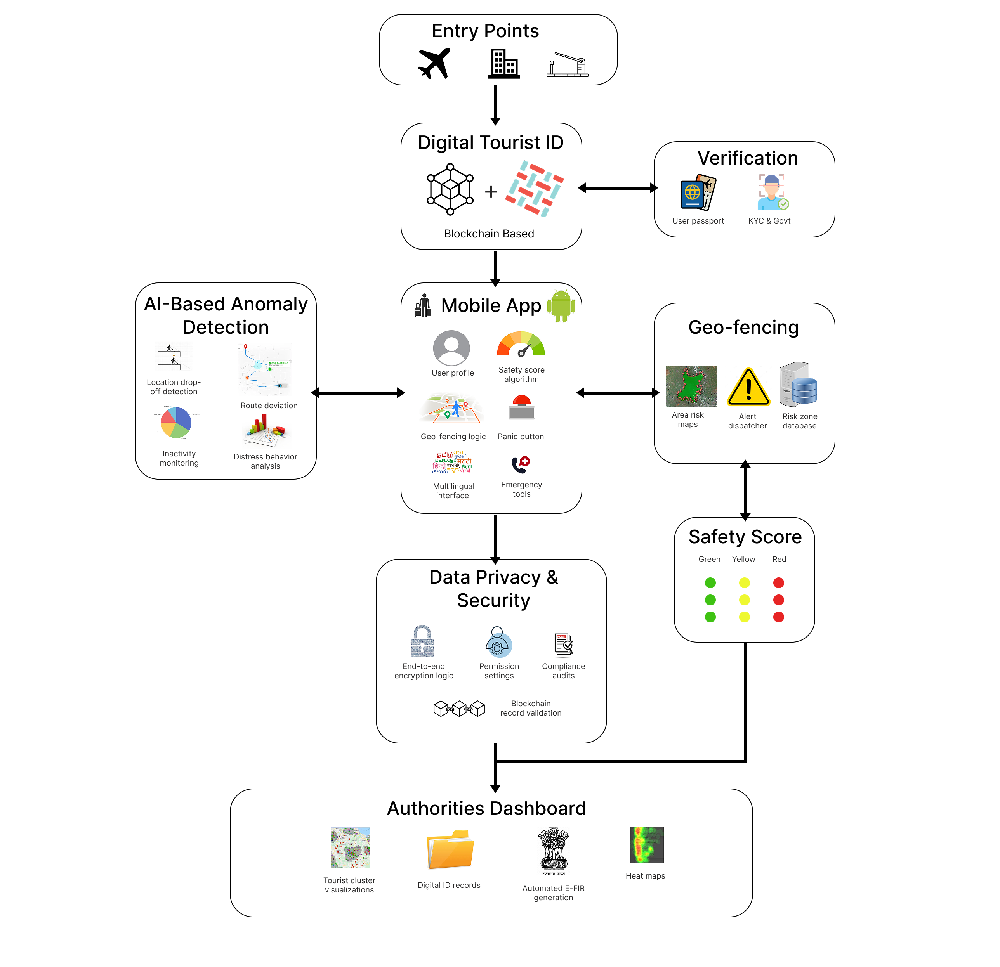
Sanchar
Blueblaze
Proposed Solution :
AI-Powered Safety Monitoring : Real-time data analysis for anomaly detection & Prediction.
Blockchain-Based Digital Tourist ID : Secure, tamper-proof identity & travel record verification.
Geo-Fencing Alerts : Automatic warnings when tourists enter high-risk or restricted zones.
Mobile Application : App for tourist for safety & easy accessibility
Authority Dashboard :Web-based dashboards for Polices & Authorities for Monitoring & Response.
Family/Companion Access : Sharing tourist location to their family members from last know location.
Solution Flow
Uniqueness :
Offline – first Emergency & Advance Safety Features.
Recommends the Nearest and fastest response unit in Emergency
Tracks the User based on Safety Score to improves Efficiency & Computational cost
Security as a Service to Government & Privacy Laws

Slide 3

TECHNICAL APPROACH
Blueblaze
Tech Stack:
Frontend : React.js, TypeScript, Tailwind CSS, Kotlin + XML.
Backend : Java / Kotlin + Spring Boot, Firebase, PostgreSQL, MongoDB.
Services & APIs : Web3j, Twilio, WebSockets.
AI & ML : Python, TensorFlow, PyTorch.
c Cloud Deployment : GitHub, Docker, Kubernetes.

Slide 4
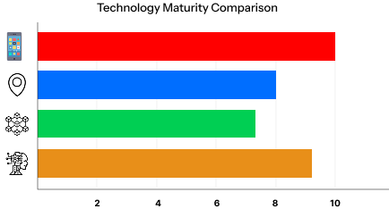
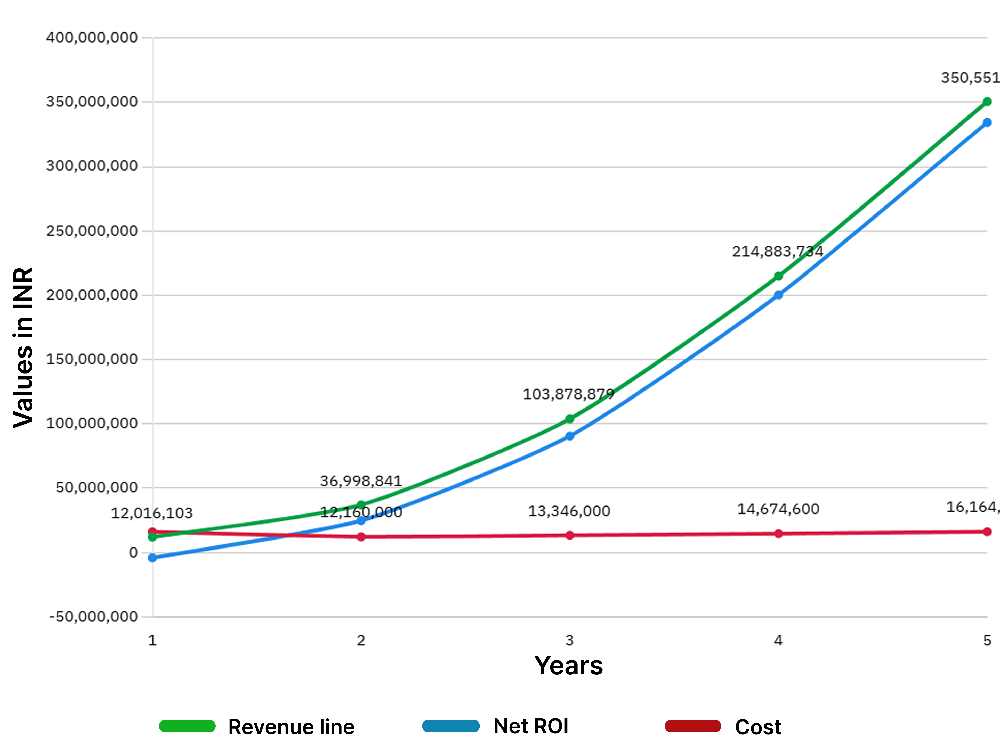
FEASIBILITY AND VIABILITY
Blueblaze
Feasibility:
Strong Need : Tourism safety is a priority, especially in risky & remote areas.
Tech is Ready : AI, blockchain IDs, and geo-fencing already work well today.
Integration Possibility : Can link with 112 emergency helpline, police, and tourism systems.
Risk & Solutions :
No Internet/Low Network : SMS SOS + cached maps.
Emergency Delays : Human Verified escalation before 112 dispatch.
Privacy Concerns : Minimal data + blockchain + DPDP compliance.
Multi-Sided Platform Business Model :
One App for All: Tourists use the app to book hotels, taxis, buses, and tours
Commissions: Every booking gives us a small cut.
Win-Win-Win: Tourists stay safe, providers get more customers, and authorities save cost with automated monitoring.

Slide 5

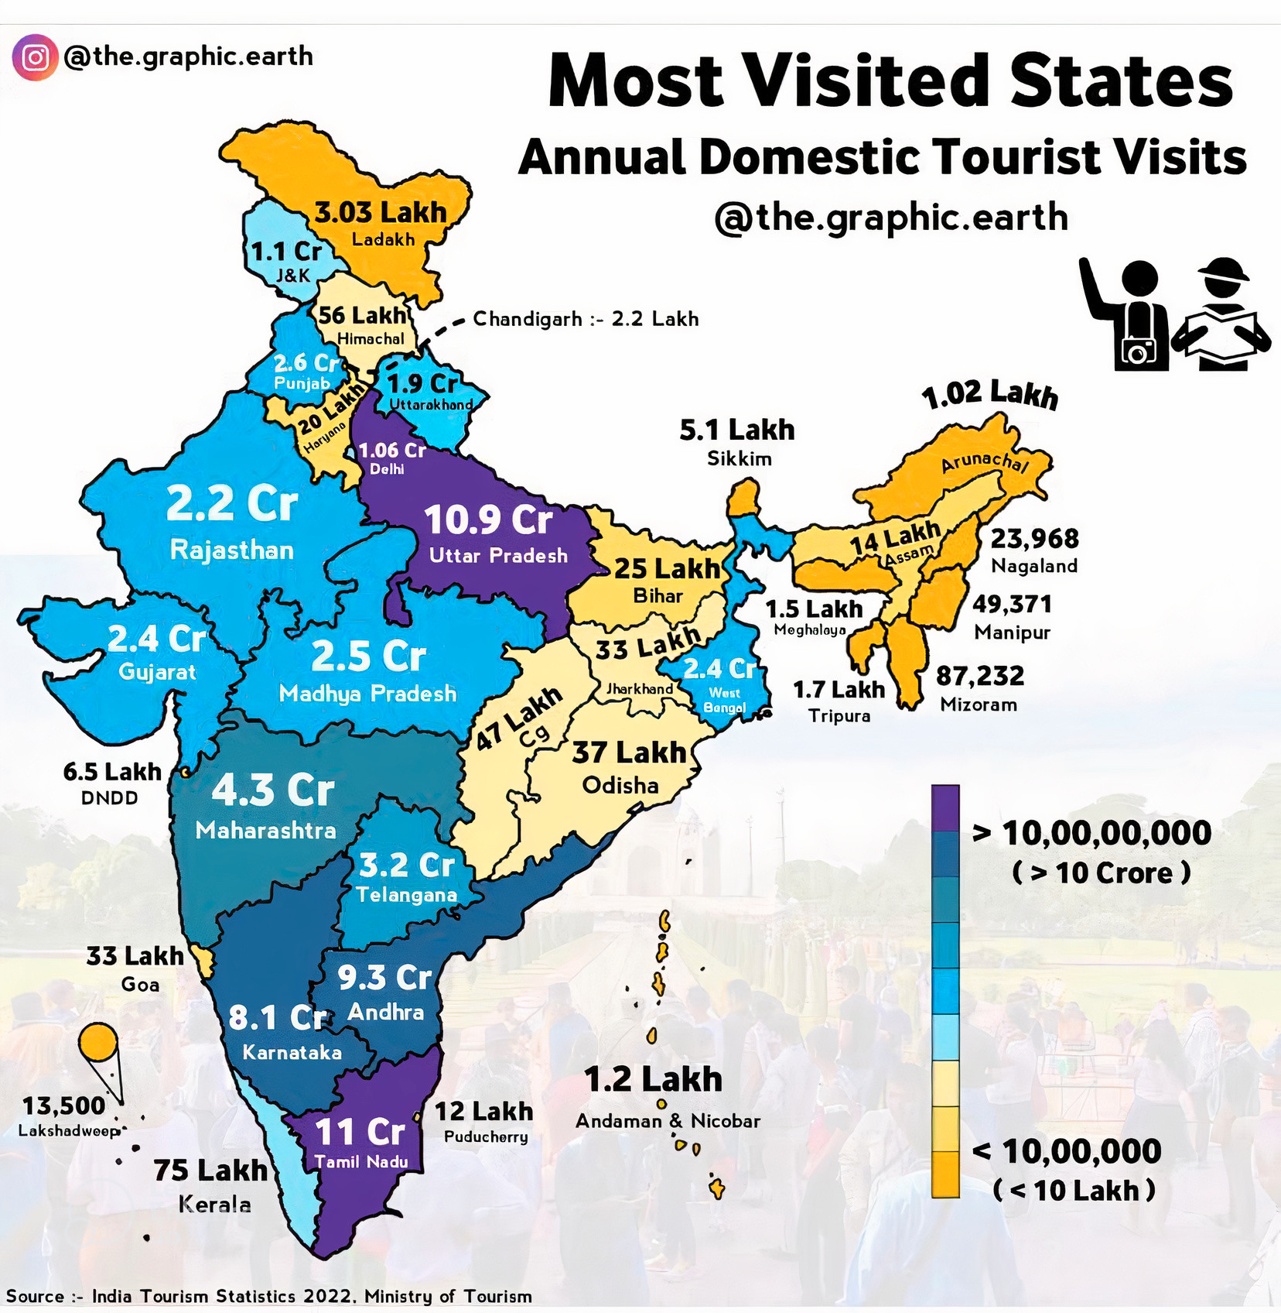
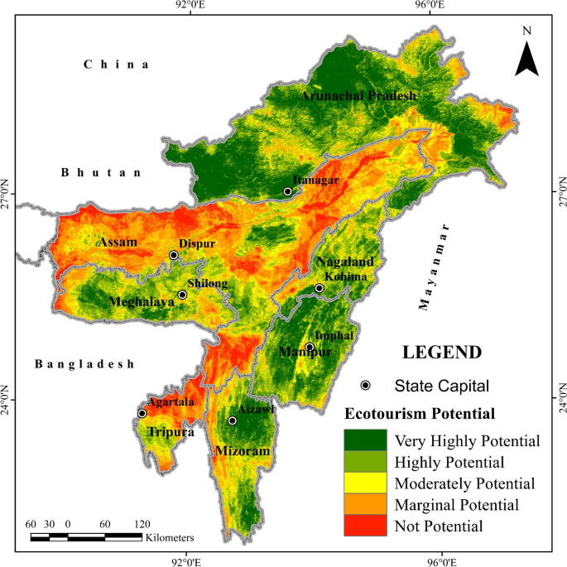
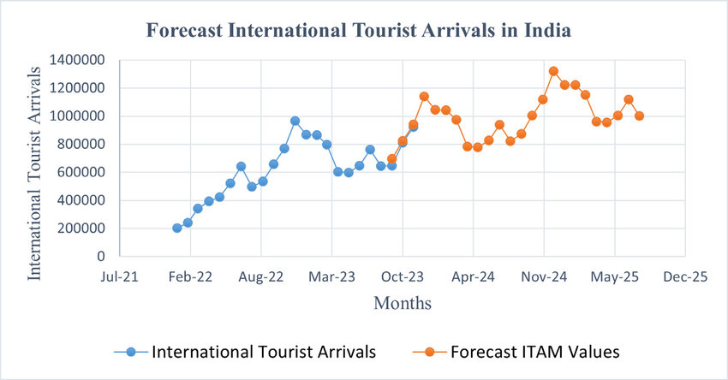
IMPACT AND BENEFITS
Blueblaze
Benefits of Solution :
Social:
Builds trust in tourism
Safer travel for women & elderly
Economic:
Commission from in-app bookings
More revenue for local services
Environmental:
Shared mobility = lower carbon footprint
Prevents overcrowding in sensitive areas
Potential Impact :
Tourists :
Safer travel with AI alerts & SOS
One app for safety + bookings
Authorities (Police, Tourism Dept., MDoNER):
Real-time dashboards for clusters & high-risk zones
Faster response with automated e-FIR

Slide 6




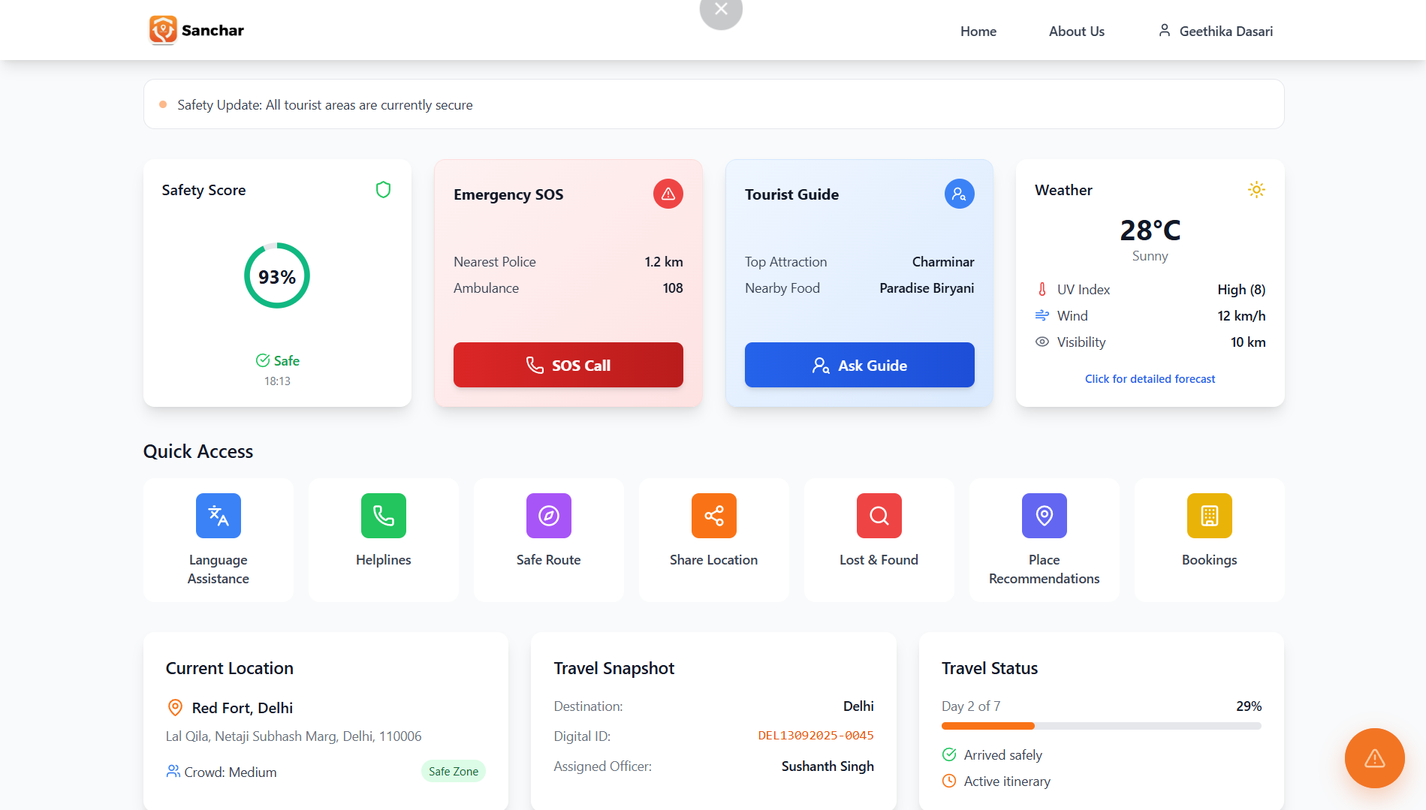
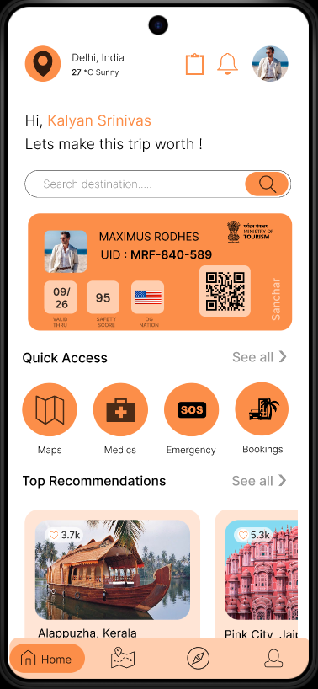
RESEARCH AND REFERENCES
Blueblaze
Key References :
• ERSS / 112 India — official emergency response portal
• NIDHI — National Integrated Database of Hospitality Industry (MoT)
• National Digital Tourism Mission (NDTM) — Task Force report (PDF)
• SIH 2025 — Problem Statements (includes 'Smart Tourist Safety Monitoring')
• W3C — Decentralized Identifiers (DID) core specification
• Meghalaya — Mandatory online guest data collection (state PDF)
App References :
Sanchar (Our App):
Further Reading :
• Mapbox — Geofencing docs & guides
• Trajectory anomaly detection — arXiv / normalizing flows (2004.05958)
• CETrajAD — Ensemble trajectory anomaly detection (CMU PDF)
• MDPI — Digital identity blockchain ecosystem (applied paper)
• Sikkim — Smart tourism research / 'Sikkim Darshan' digital platform
Web Link : Sanchar
App Link : Sanchar

